Slide 1


FYP Internal Presentation
1
Notes:
1

Slide 2

Community Service Provider
Supervised by:
Sir Muhammad Kamran
Group Members:
Ubaid-ur-Rehman ( SP17-BSE-015 )
Sheraz Kamran ( SP17-BSE-014 )
Usama Anwar Malik ( SP17-BSE-034 )
Presented on December 11, 2020
Department of Computer Science
COMSATS University Islamabad,
Attock Campus
11/12/2020
FYP Internal Presentation
2

Slide 3
Outline
_______________________________
Introduction
Related Work / Applications
Problem statement
Objectives
Methodology
Modern tools
Benefits
System Architecture
Data Representation
Process Flow/Representation
System Interfaces
Conclusion
Future Work
References
_______________________________
11/12/2020
FYP Internal Presentation
3
Notes:
3

Slide 4

Introduction
_______________________________
Community Service Provider is a cross platform (Android + Website) application customized for town to provide online services.
It is becoming a trend for rich business groups to build housing societies as a business.
To compete with other businesses, it is required to catch customers by providing services in unique, computerized and better ways.
For such community/society, their exist an opportunity for a computerized system which leads to ultimate ease and satisfaction of residents of community.
Hence, due to day by day increasing need, developing such system is promising as profitable business.
_______________________________
11/12/2020
FYP Internal Presentation
4

Slide 5
Related Work / Applications
_______________________________
The services we combined in our application are customized for a town.
These services resemble, in functionalities, some applications that are used for the same purposes and are stand-alone.
Such applications and websites, that are in function, are;
Amazon: For online Shopping. [1]
Pakistan Citizen Portal: For putting online complaints. [2]
BookItNow.pk: For online ticket booking. [3].
_______________________________
11/12/2020
FYP Internal Presentation
5

Slide 6
Problem Statement
_______________________________
Applications that facilitate online booking, shopping, billing, buying and selling etc makes life easier.
These applications mostly act as stand-alone applications which require interaction to multiple interfaces.
This results in problems for users, mostly for those that are unable to keep-up with the technology, to cope with multiple applications as well as their interfaces.
_______________________________
11/12/2020
FYP Internal Presentation
6

Slide 7
Continued...
_______________________________
The problems, that users face more often, include;
Log in/out for separate applications.
Different UIs to interact with different application.
Hence, to solve such problems and satisfy the users needs, it is necessary to have a single application enabling the user to fulfil daily tasks efficiently and with ease.
_______________________________
11/12/2020
FYP Internal Presentation
7

Slide 8
Objectives
_______________________________
Online reservation.
Availing (renting) vehicles.
Ordering a meal or fast food online.
Online hiring of services of the town.
Online payment of bills.
Reduce unnecessary cost and time spent on going to market.
Learning and development of efficiently working software.
Availing the Business opportunity.
_______________________________
11/12/2020
FYP Internal Presentation
8

Slide 9
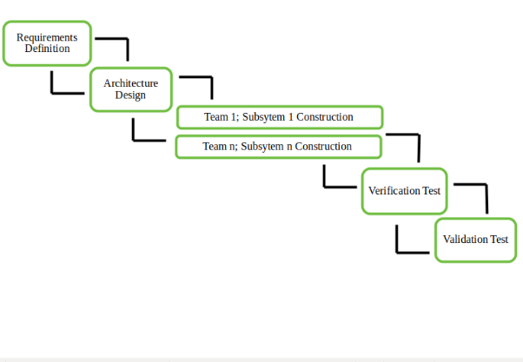
Methodology
_______________________________
For this project, following SDLC Model and methodology is selected,
We would be using Incremental model for this project.
An incremental model is a continuous module development software development life-cycle model in which the requirements comes as is and its development starts without waiting for other requirements to complete.
_______________________________
11/12/2020
FYP Internal Presentation
9

Slide 10
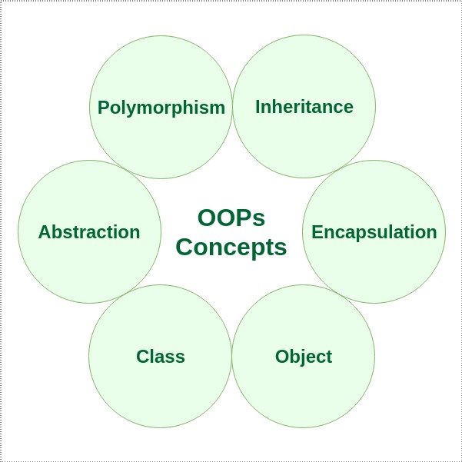
Continued…
_______________________________
Object-oriented programming approach is chosen as a methodology.
It’s a concept of having classes that contains attributes and methods and objects which are representation of those classes.
_______________________________
11/12/2020
FYP Internal Presentation
10

Slide 11
Modern Tools and Technologies
_______________________________
Tools | Versions | Rationale
Android Studio & Android SDK | 3.5 & 26.1.1 | For Front-end Development of Android Application.
Java JDK | 12.0.2.0 | For Back-end Development of Android Application.
Bootstrap4, HTML5, CSS3 |  | For front-end Development of Website.
PHP | 4.9.1 | Server-side Language.
MySQL | 2008 | Centralized Database.
Star UML & Visual Paradigm | 3.2.2 & 16.1 | For Creating Diagrams and Charts.
Visual Studio Code | 1.45.0 | Used as Code Editor.
_______________________________
11/12/2020
FYP Internal Presentation
11

Slide 12
Benefits
_______________________________
For users:
This project will save time and monetary cost spent on reaching and finding trustworthy services to avail.
Interaction with the service providers will become faster and authentic.
Reservation of multiple requirements will be easier. These include car, seats in hotel or café etc.
As a whole, this application will act as ‘one-stop shop’ for the residents of the town where this application is adapted.
_______________________________
11/12/2020
FYP Internal Presentation
12

Slide 13
Continued...
_______________________________
For developers:
This project will award the developers with practical experience of the market.
It will provide the developers the opportunity to learn and polish their development skills.
From the business POV, this project has the potential to provide monetary benefit to the developers.
_______________________________
11/12/2020
FYP Internal Presentation
13

Slide 14






System Architecture
_______________________________
Desktop
User
Internet
Mobile
Server
Manager
Desktop
Internet
_______________________________
11/12/2020
FYP Internal Presentation
14

Slide 15
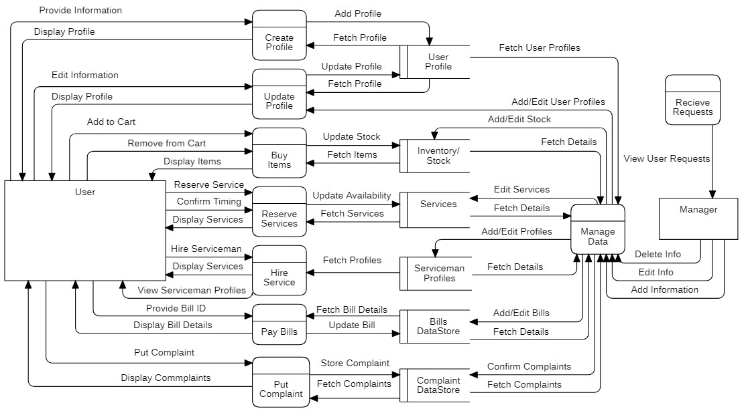
Data Representation
_______________________________
_______________________________
11/12/2020
FYP Internal Presentation
15

Slide 16
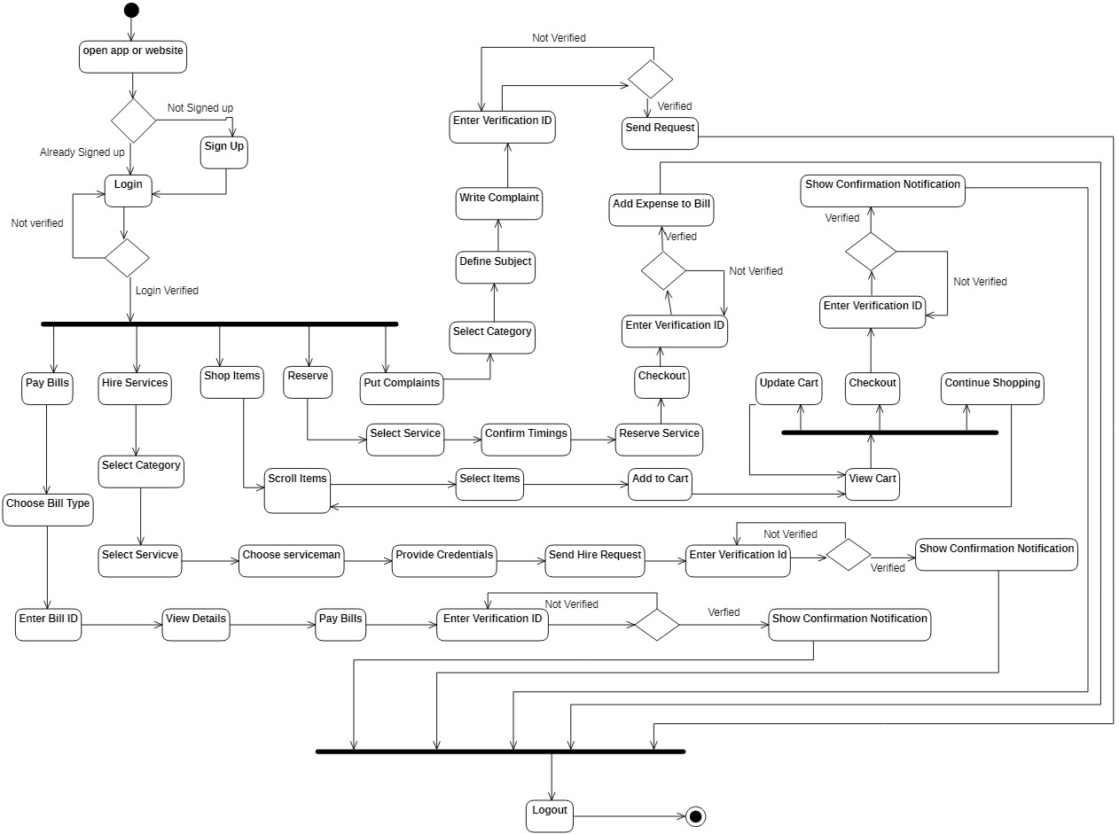
Process Flow / Representation
_______________________________
_______________________________
11/12/2020
FYP Internal Presentation
16

Slide 17
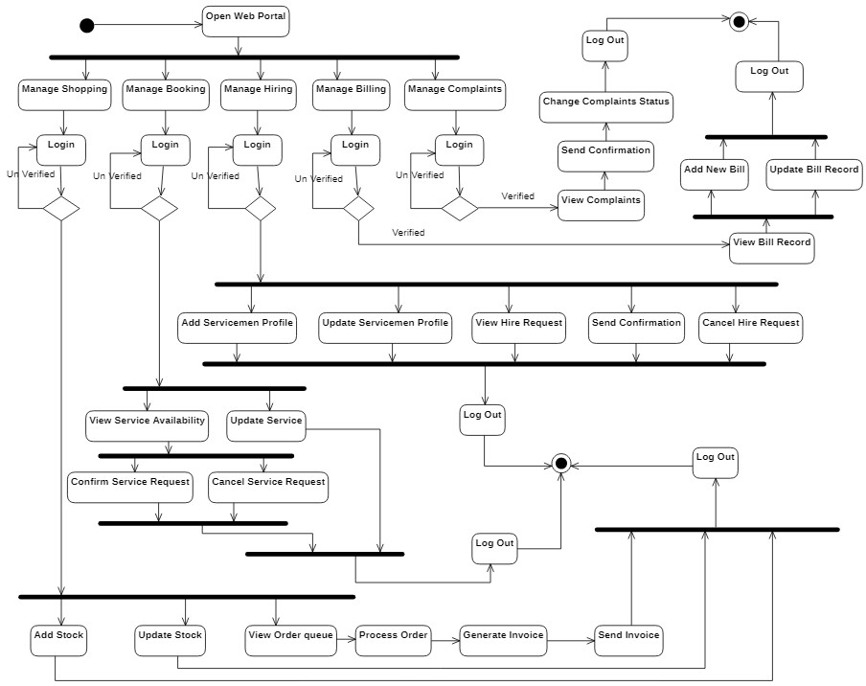
Continued…
_______________________________
_______________________________
11/12/2020
FYP Internal Presentation
17

Slide 18
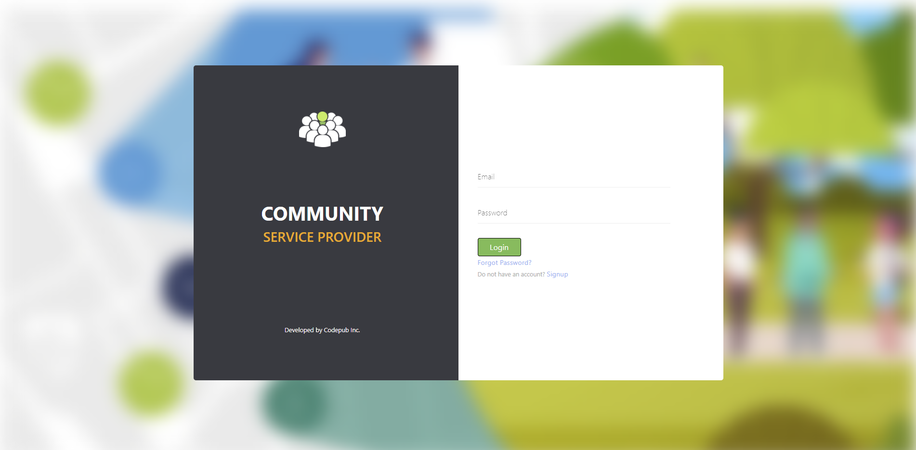
System Interfaces: Login
_______________________________
_______________________________
11/12/2020
FYP Internal Presentation
18

Slide 19
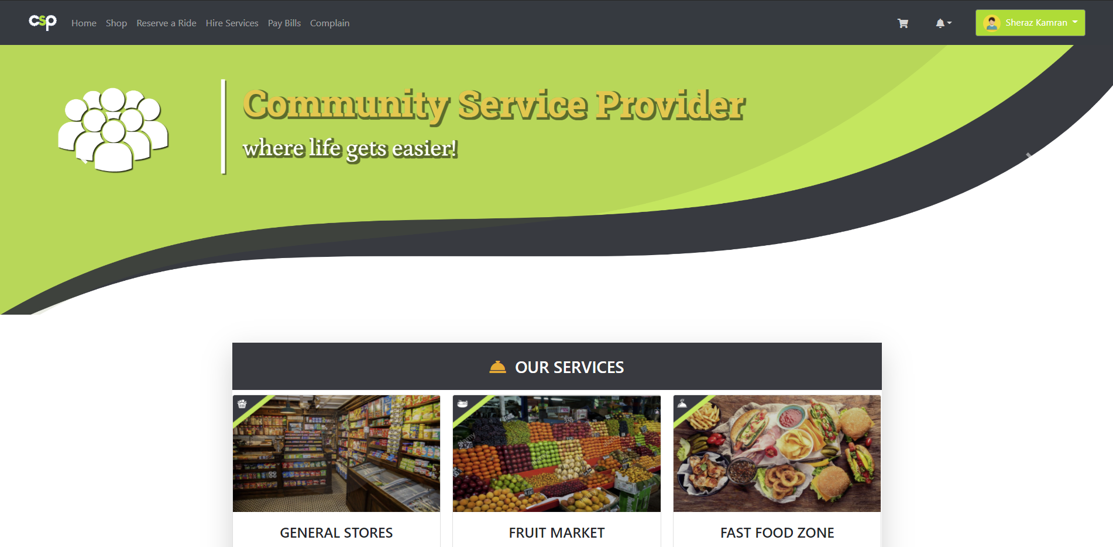
System Interfaces: Home
_______________________________
_______________________________
11/12/2020
FYP Internal Presentation
19

Slide 20
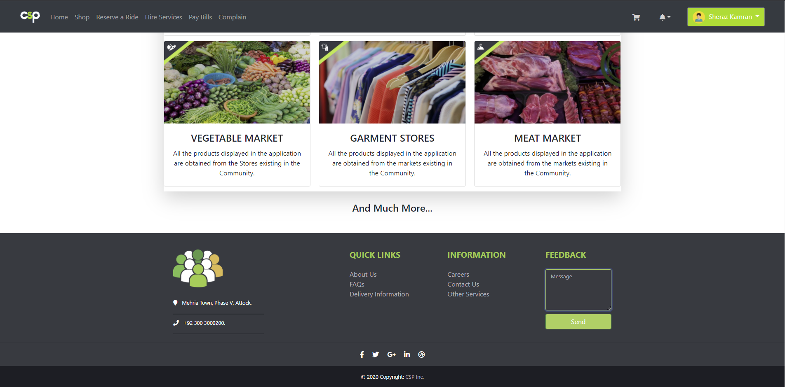
System Interfaces: Home (2)
_______________________________
_______________________________
11/12/2020
FYP Internal Presentation
20

Slide 21
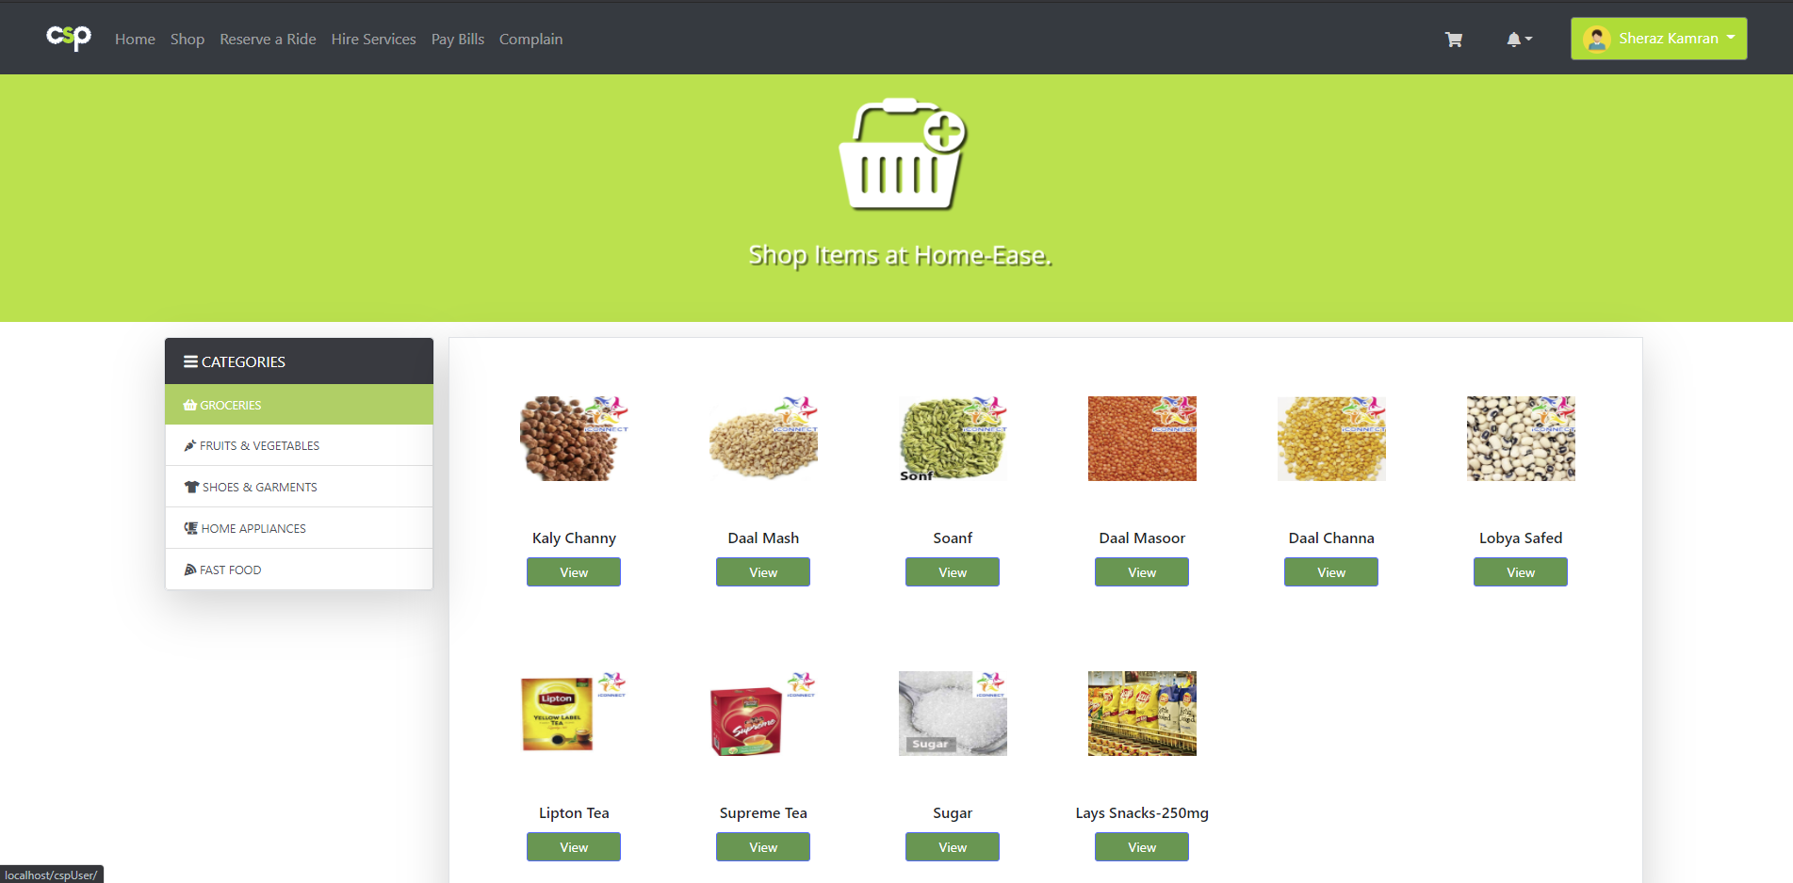
System Interfaces: Shop
_______________________________
_______________________________
11/12/2020
FYP Internal Presentation
21

Slide 22
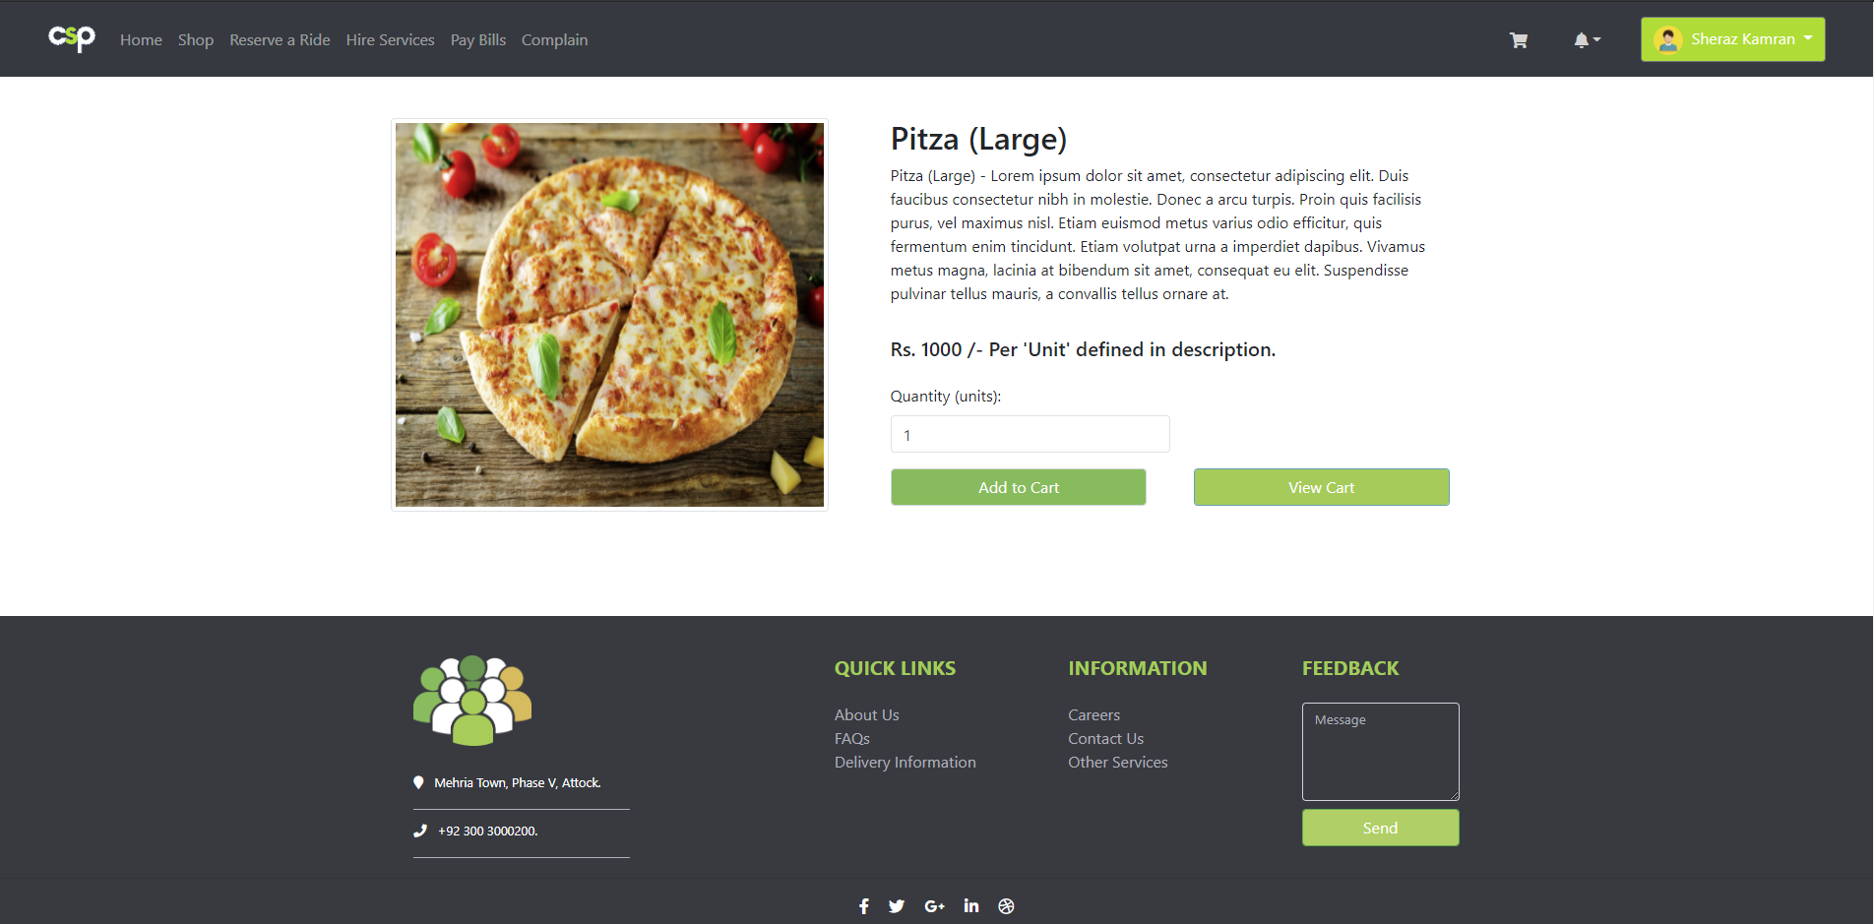
System Interfaces: Shop (2)
_______________________________
_______________________________
11/12/2020
FYP Internal Presentation
22

Slide 23
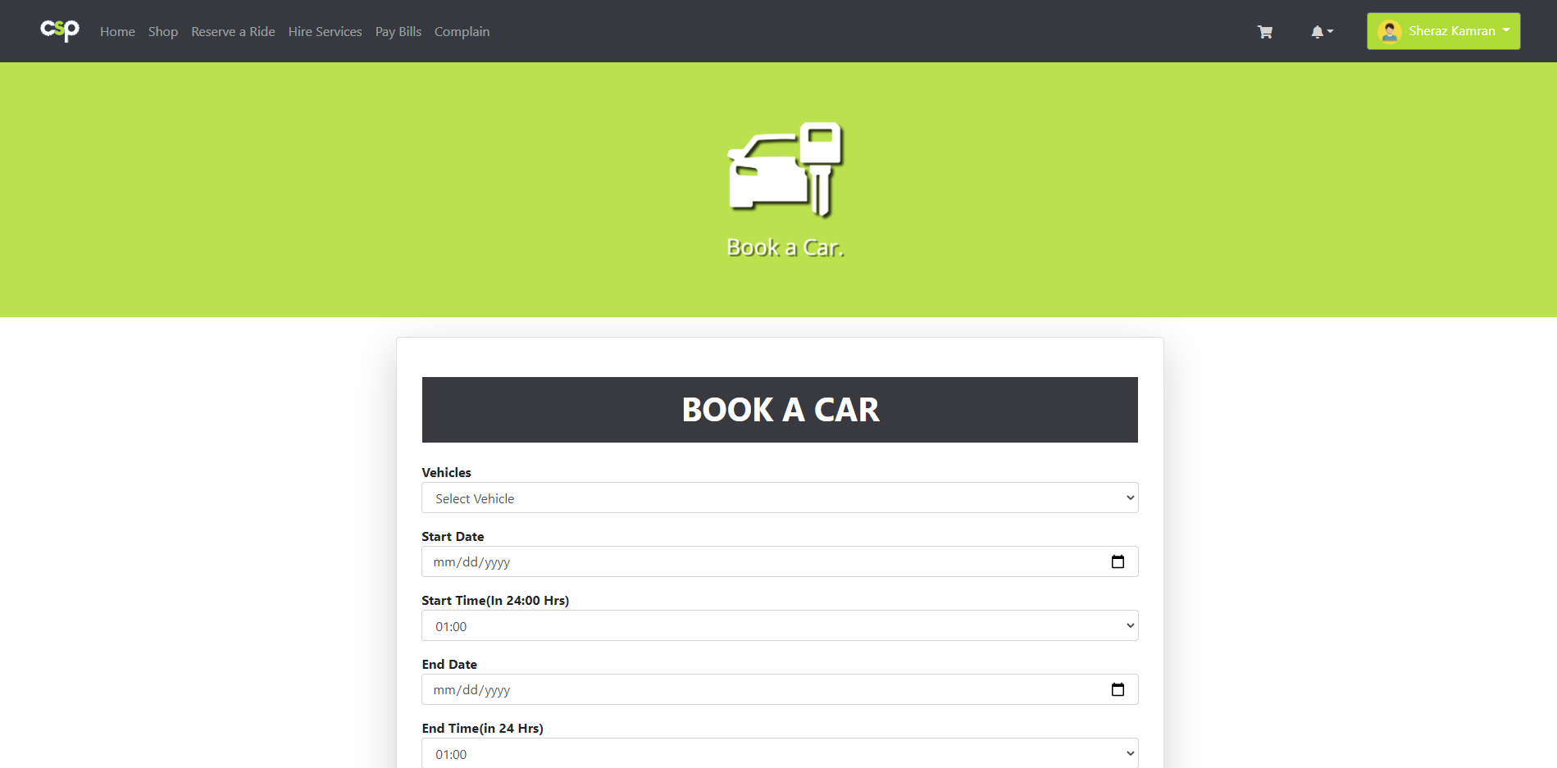
System Interfaces: Reserve
_______________________________
_______________________________
11/12/2020
FYP Internal Presentation
23

Slide 24
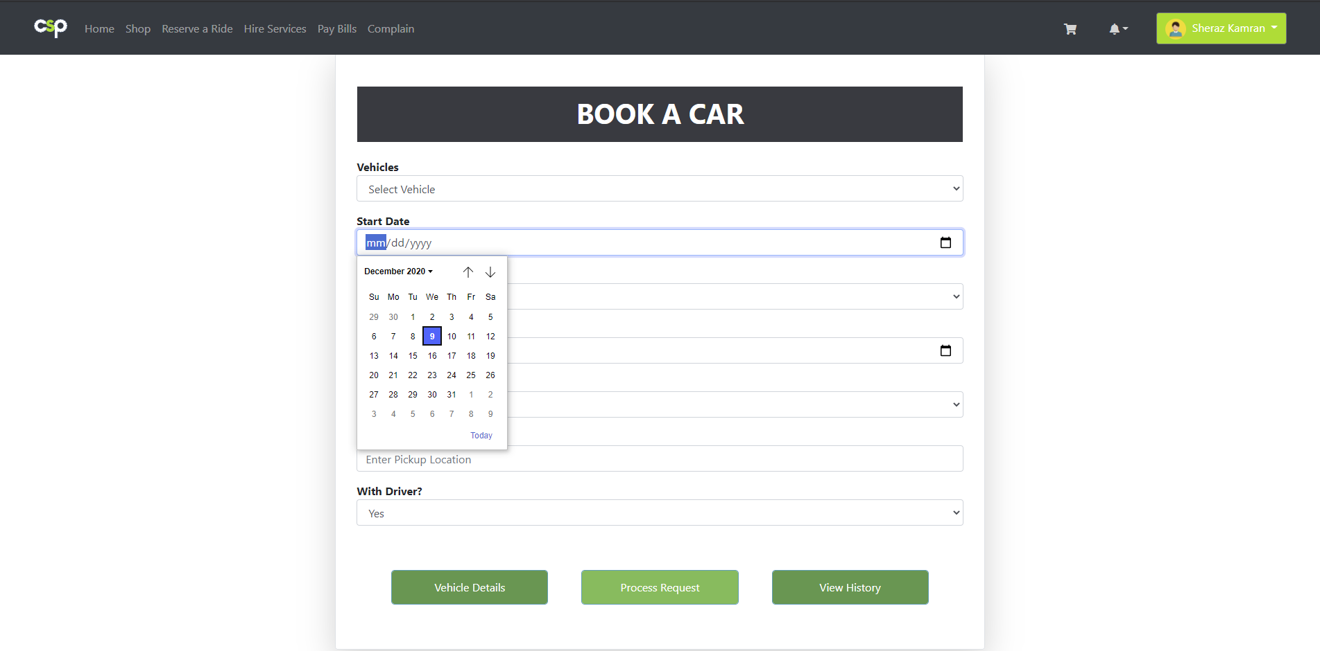
System Interfaces: Reserve (2)
_______________________________
_______________________________
11/12/2020
FYP Internal Presentation
24

Slide 25
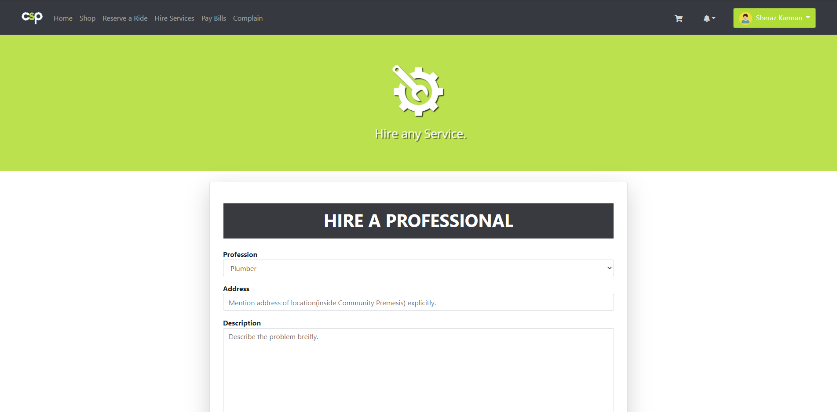
System Interfaces: Hire Service
_______________________________
_______________________________
11/12/2020
FYP Internal Presentation
25

Slide 26
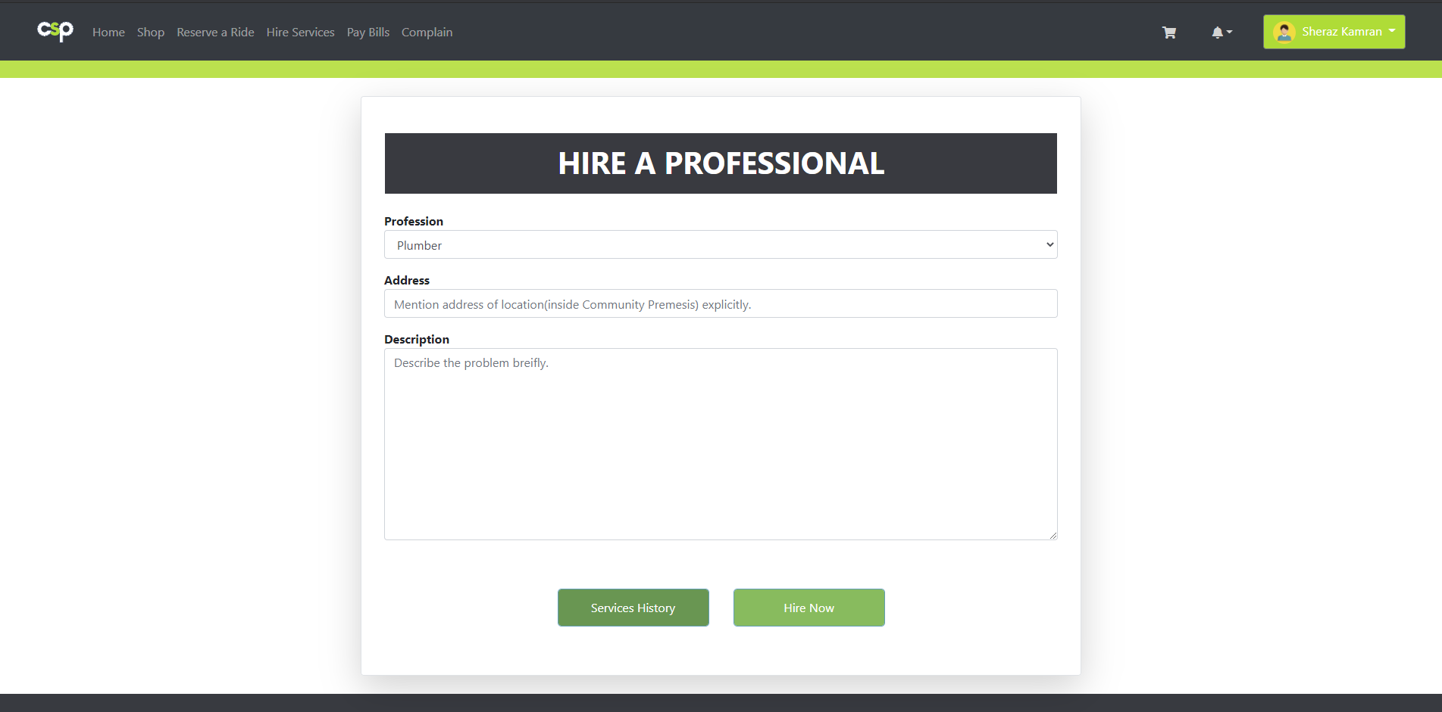
System Interfaces: Hire Service (2)
_______________________________
_______________________________
11/12/2020
FYP Internal Presentation
26

Slide 27
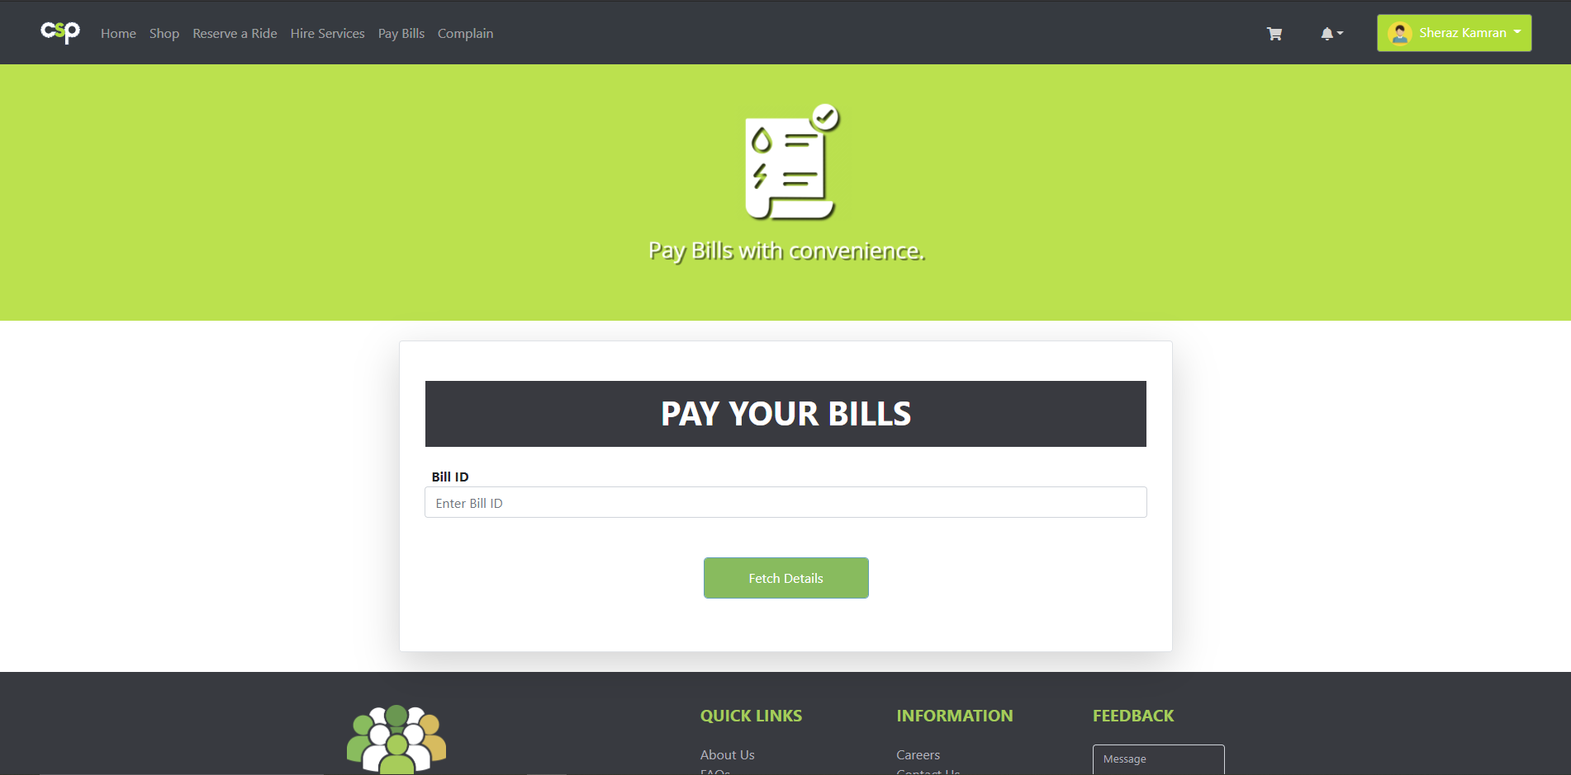
System Interfaces: Pay Bills
_______________________________
_______________________________
11/12/2020
FYP Internal Presentation
27

Slide 28
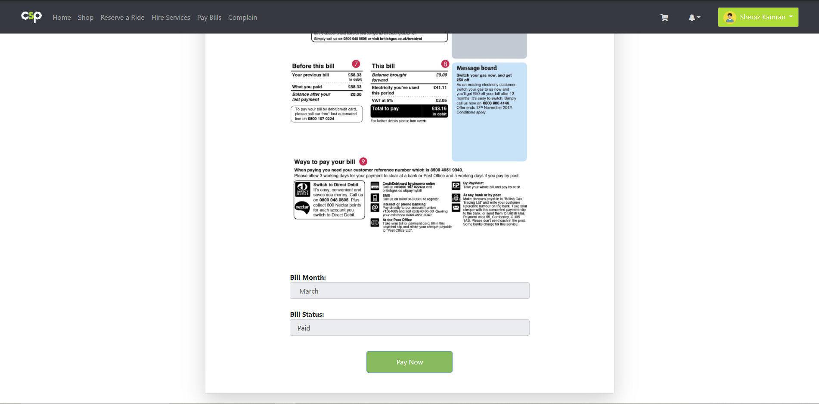
System Interfaces: Pay Bills (2)
_______________________________
_______________________________
11/12/2020
FYP Internal Presentation
28

Slide 29
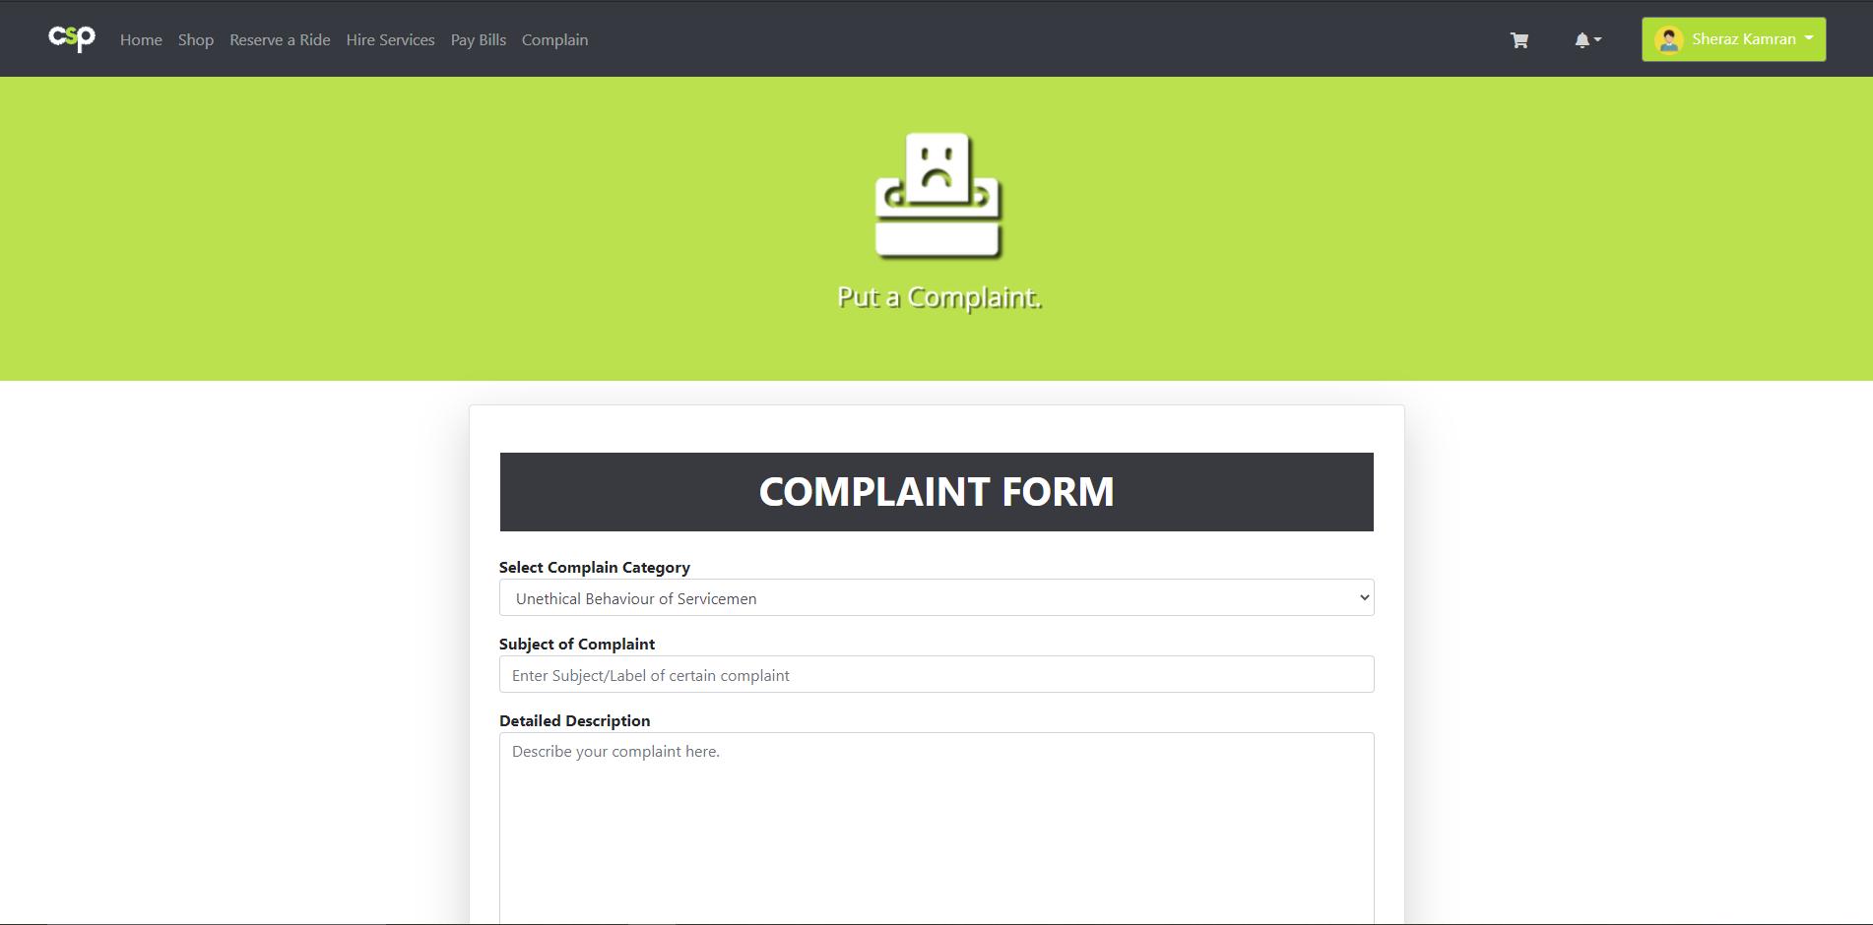
System Interfaces: Complain
_______________________________
_______________________________
11/12/2020
FYP Internal Presentation
29

Slide 30
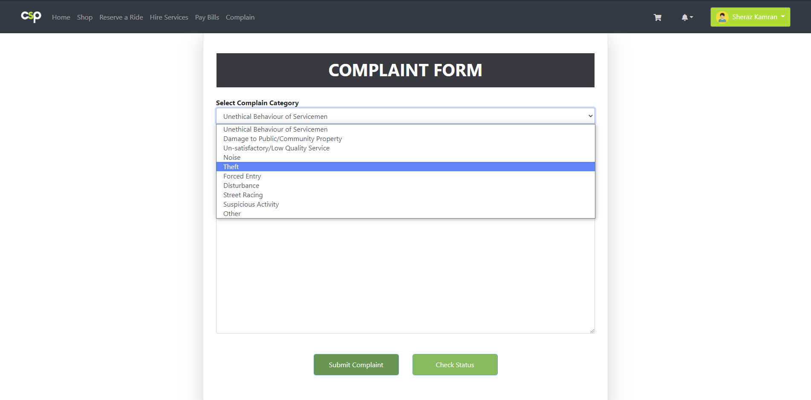
System Interfaces: Complain (2)
_______________________________
_______________________________
11/12/2020
FYP Internal Presentation
30

Slide 31
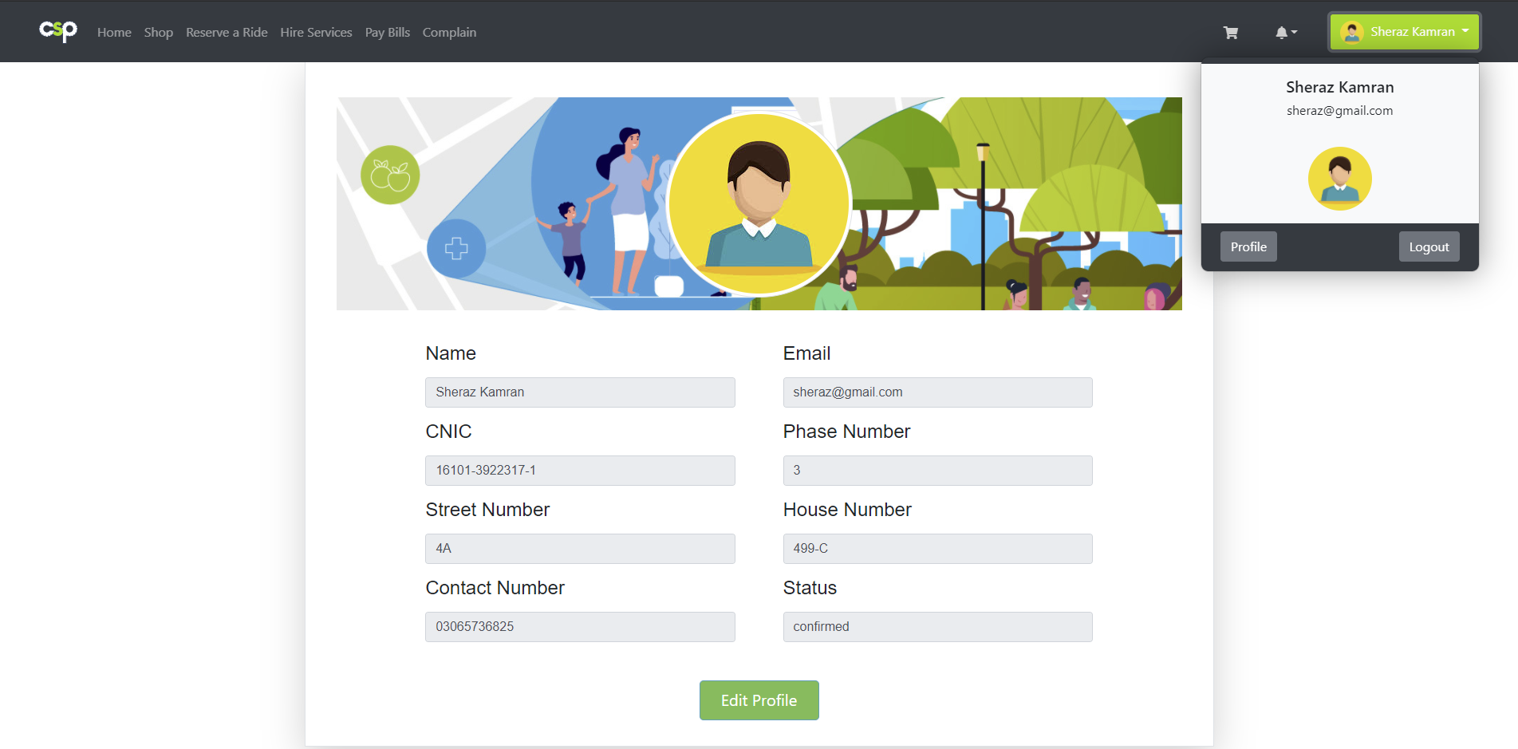
System Interfaces: Profile
_______________________________
_______________________________
11/12/2020
FYP Internal Presentation
31

Slide 32
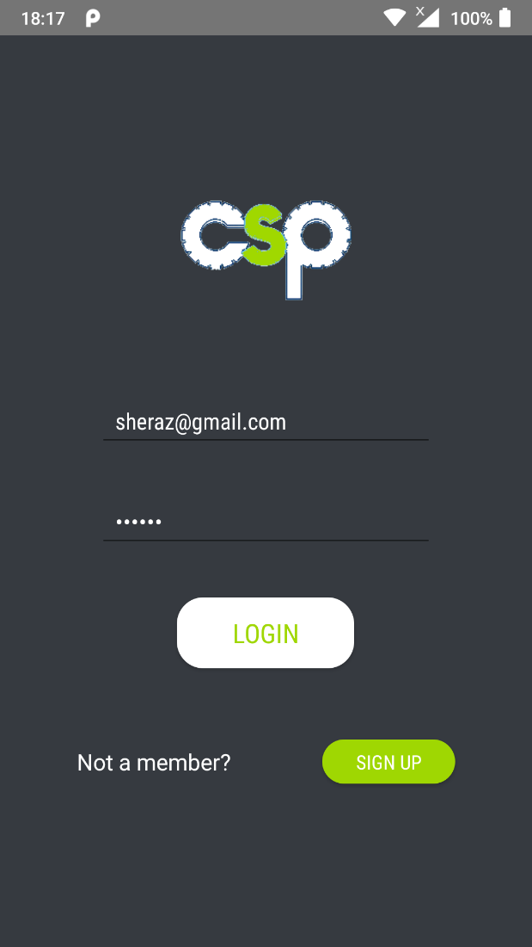
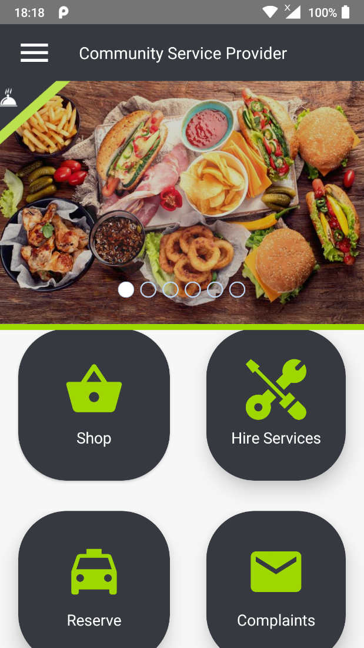
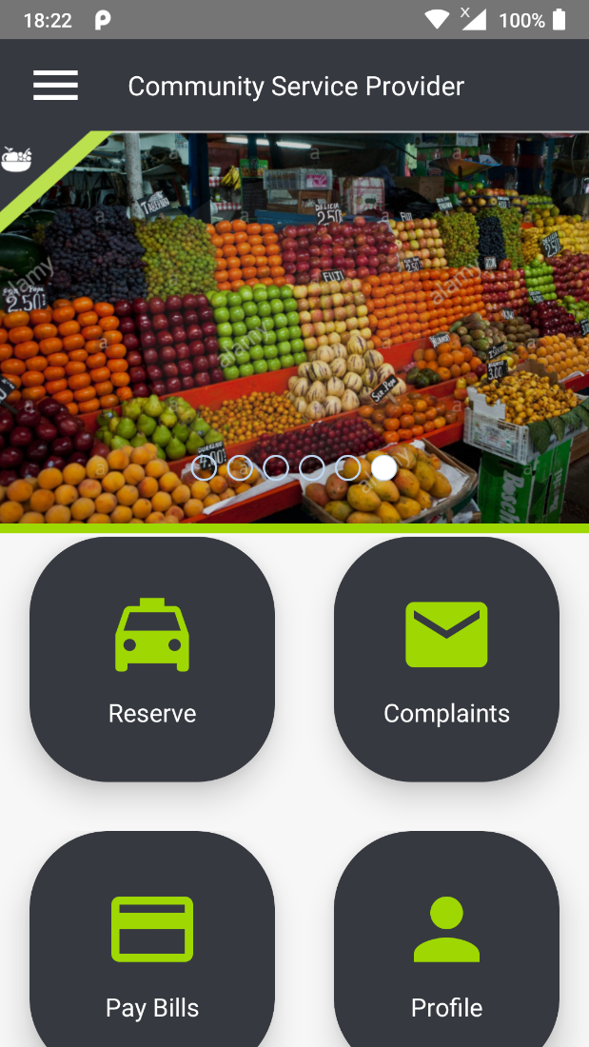
System Interfaces: Android App
_______________________________
_______________________________
11/12/2020
FYP Internal Presentation
32

Slide 33
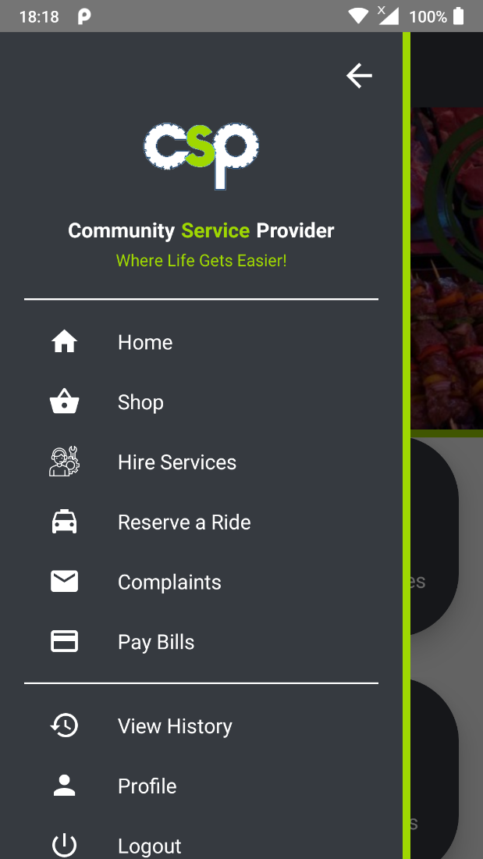
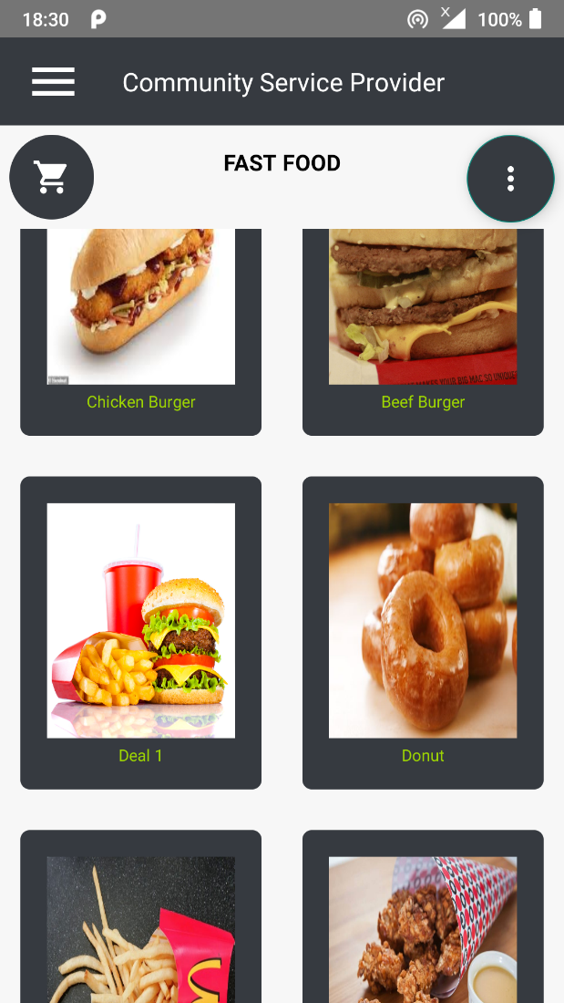
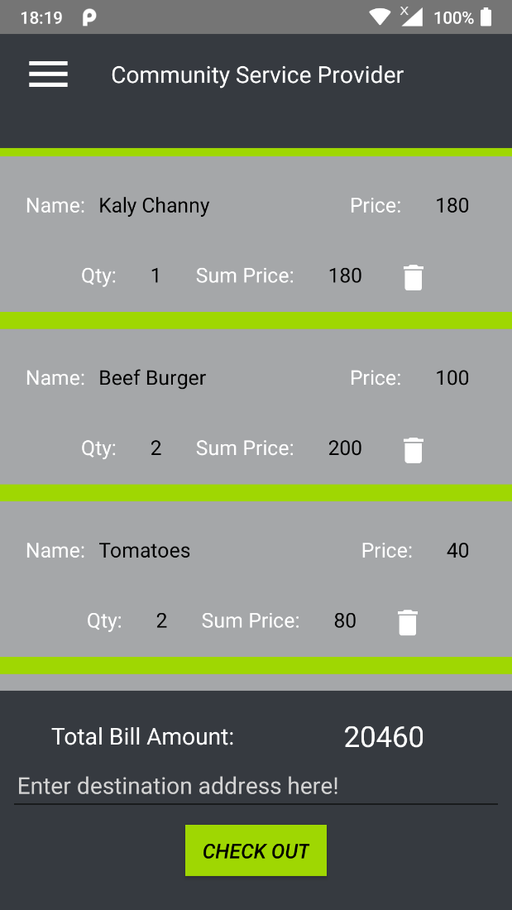
System Interfaces: Android App (2)
_______________________________
_______________________________
11/12/2020
FYP Internal Presentation
33

Slide 34
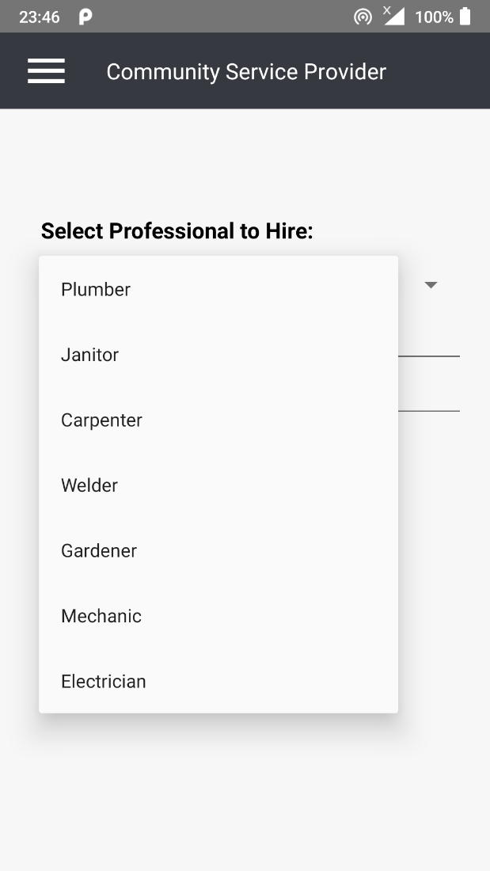
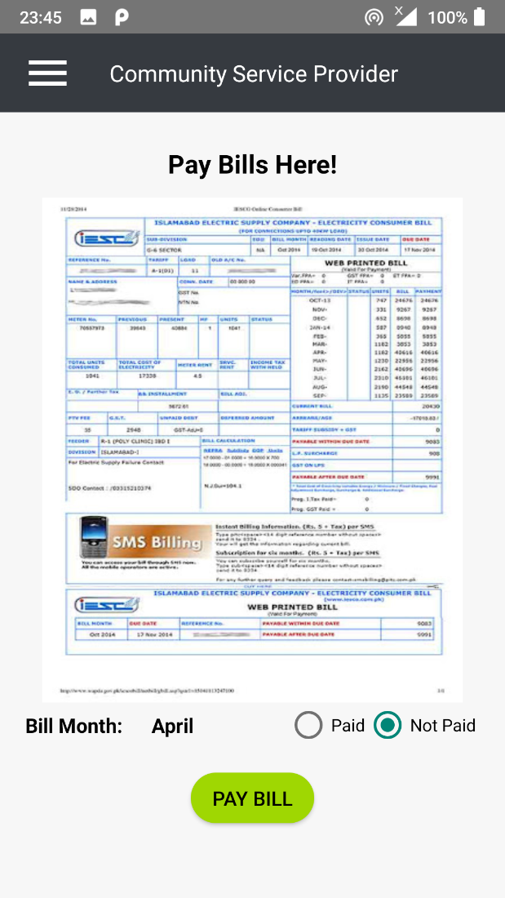
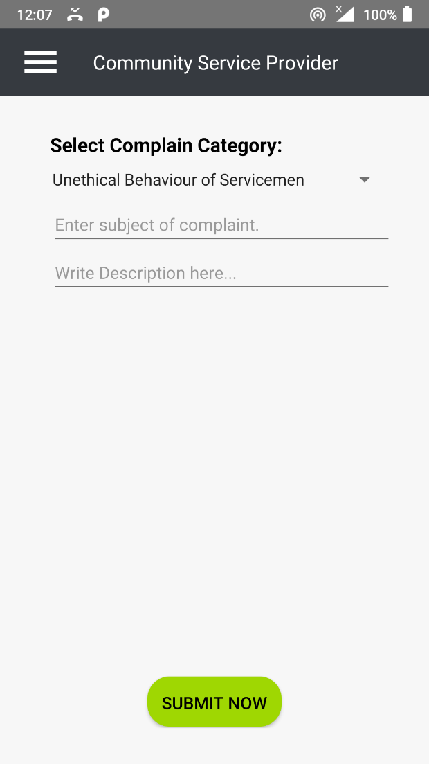
System Interfaces: Android App (3)
_______________________________
_______________________________
11/12/2020
FYP Internal Presentation
34

Slide 35
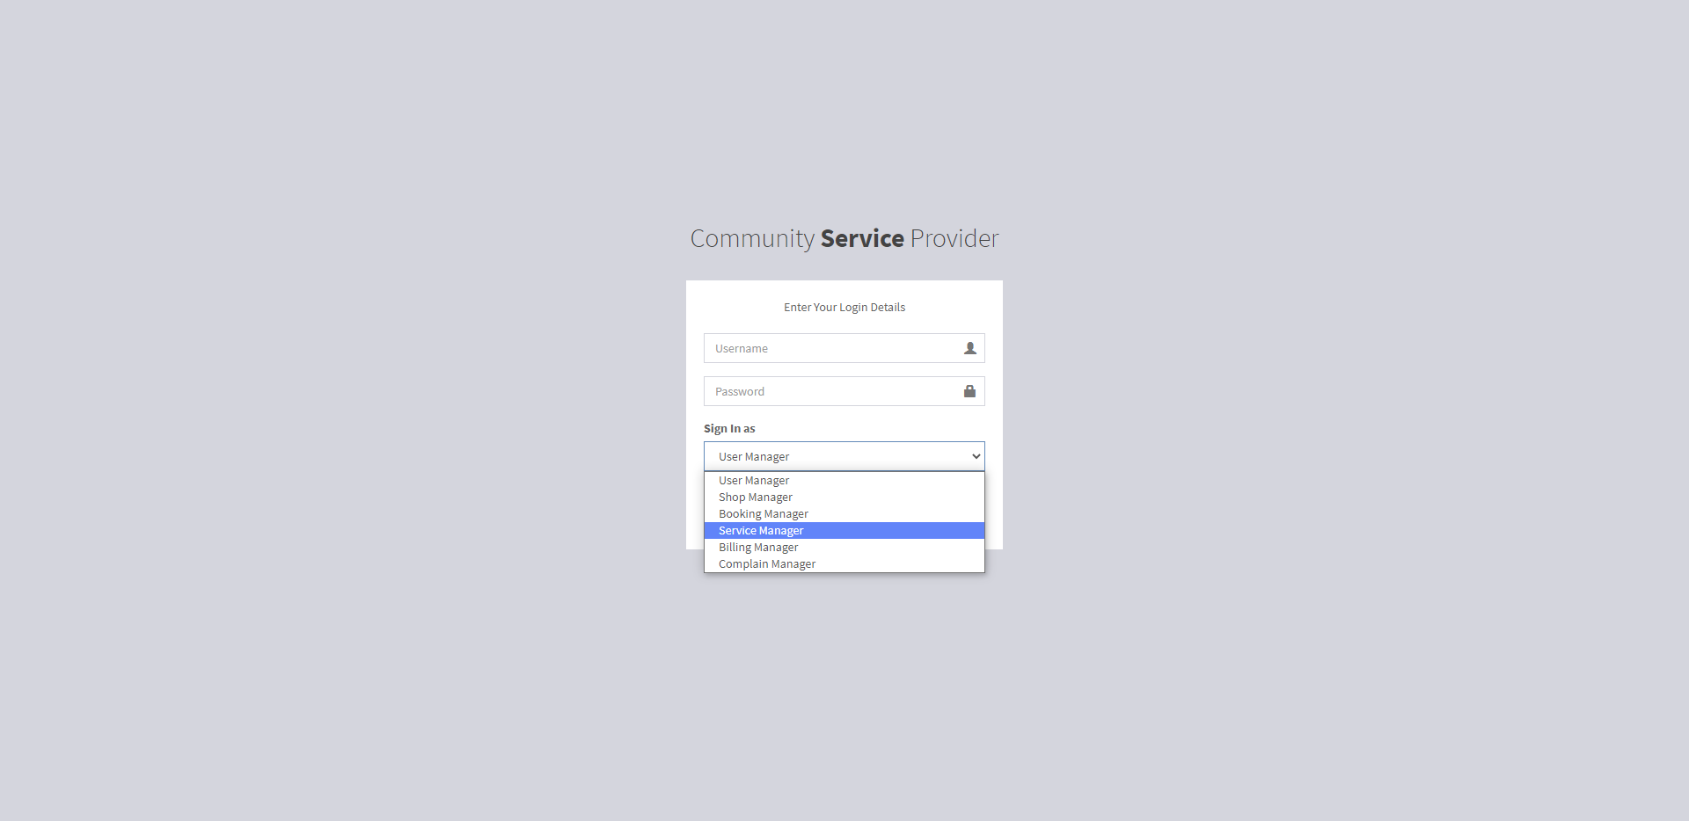
System Interfaces: Login (Web Portal)
_______________________________
_______________________________
11/12/2020
FYP Internal Presentation
35

Slide 36
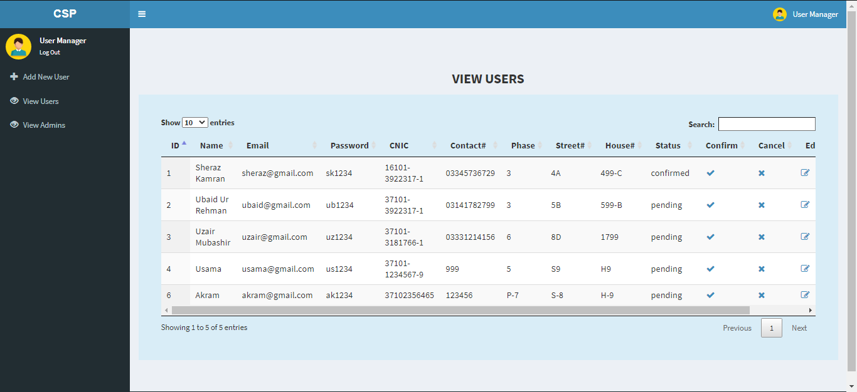
Home: User Manager
_______________________________
_______________________________
11/12/2020
FYP Internal Presentation
36

Slide 37
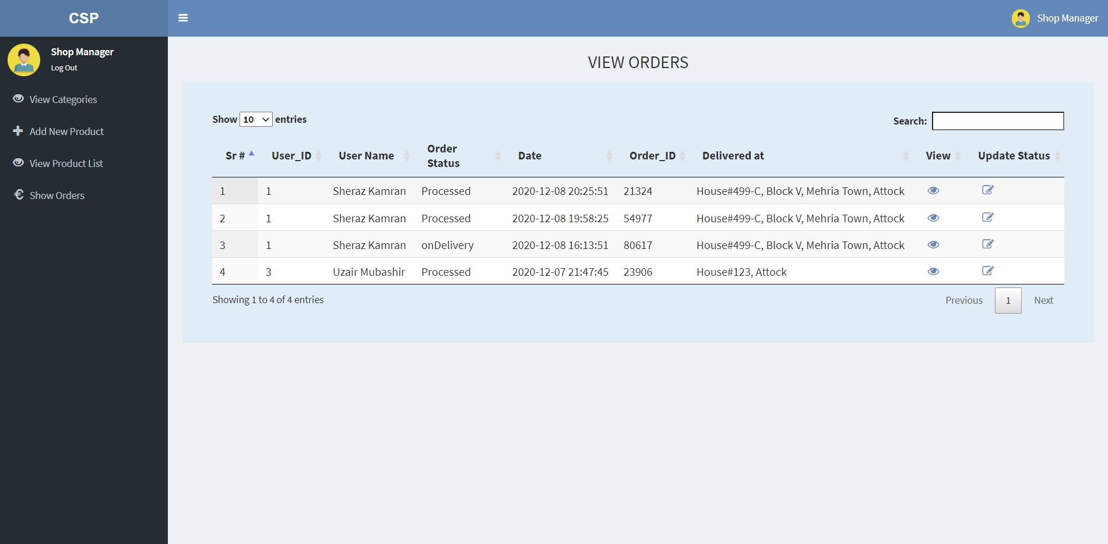
Home: Shop Manager
_______________________________
_______________________________
11/12/2020
FYP Internal Presentation
37

Slide 38
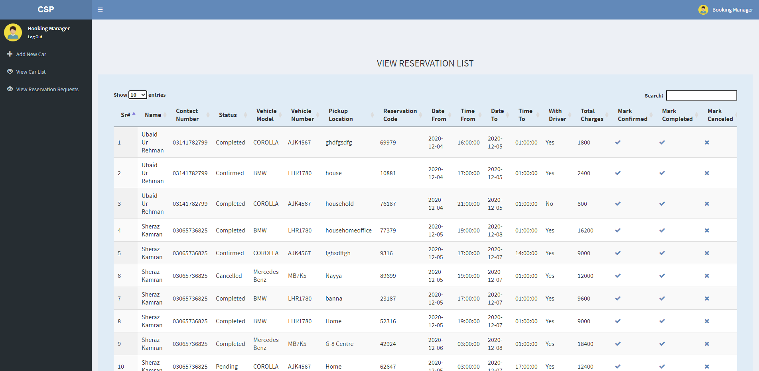
Home: Booking Manager
_______________________________
_______________________________
11/12/2020
FYP Internal Presentation
38

Slide 39
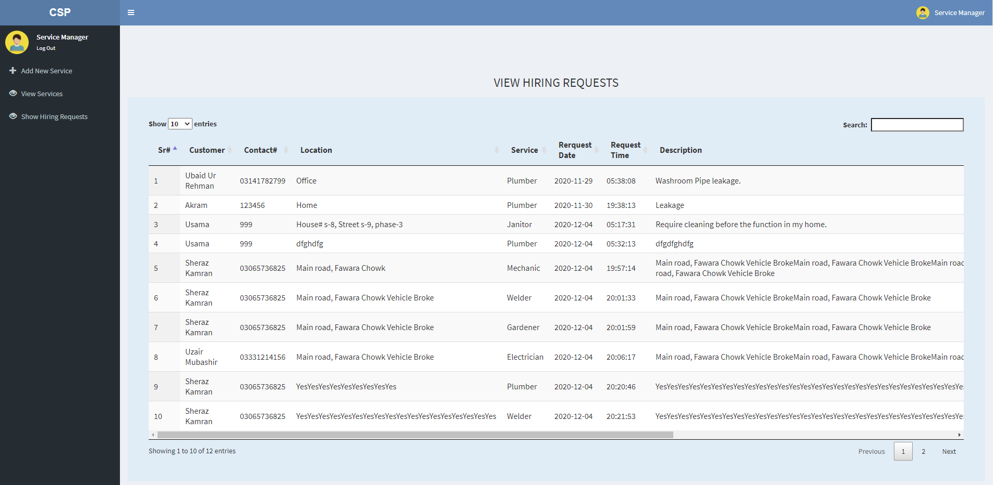
Home: Service Manager
_______________________________
_______________________________
11/12/2020
FYP Internal Presentation
39

Slide 40
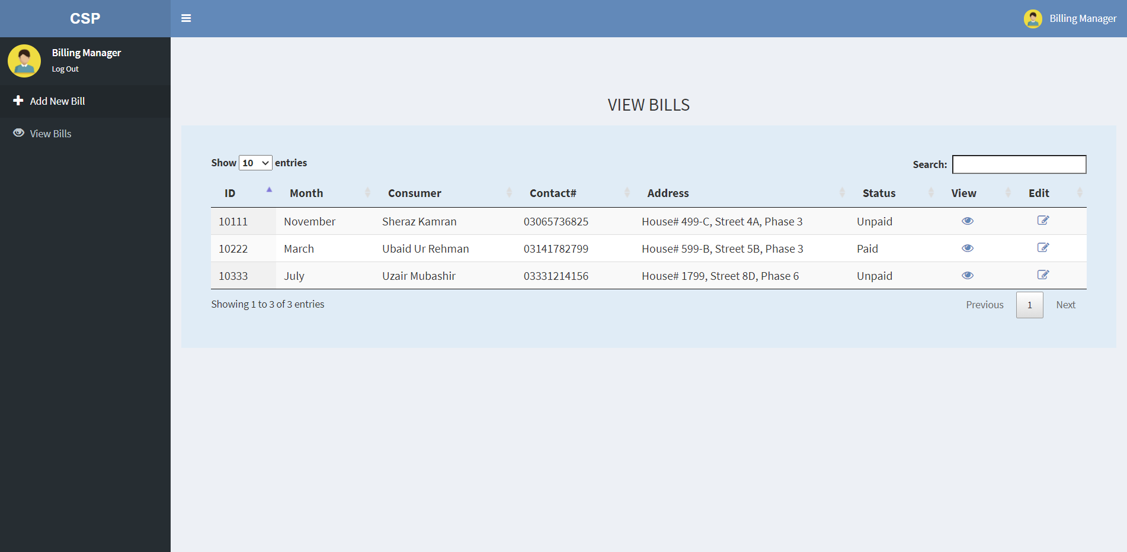
Home: Billing Manager
_______________________________
_______________________________
11/12/2020
FYP Internal Presentation
40

Slide 41
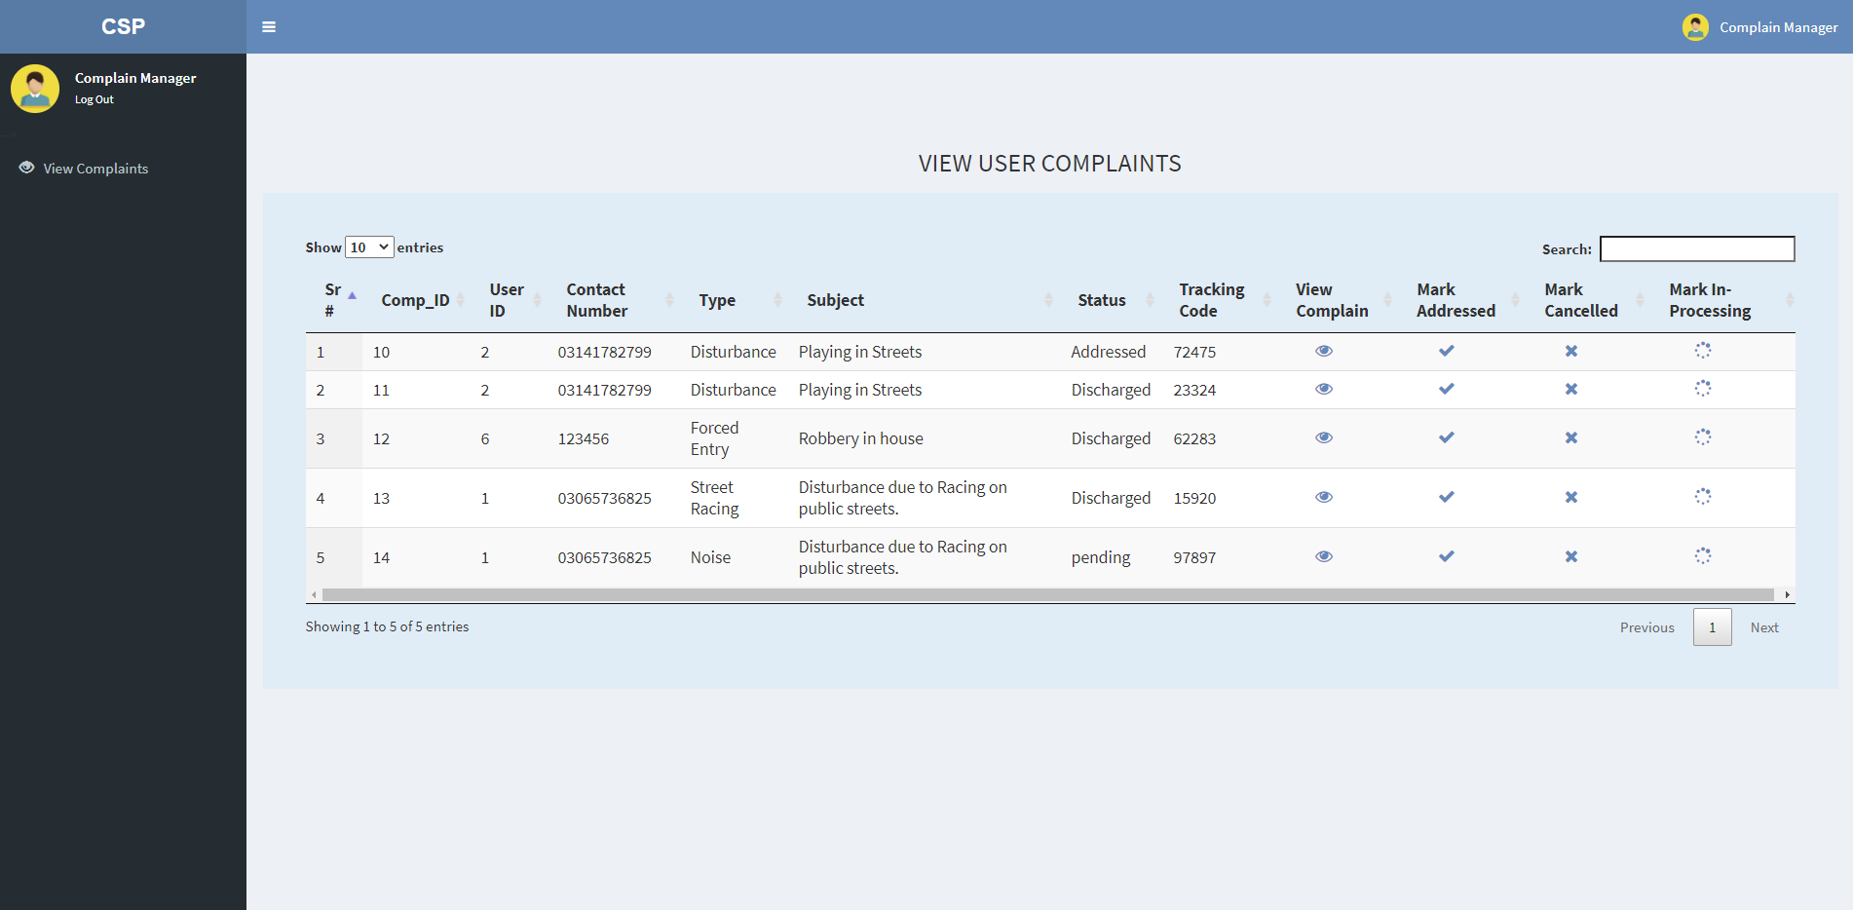
Home: Complain Manager
_______________________________
_______________________________
11/12/2020
FYP Internal Presentation
41

Slide 42
Conclusion
_______________________________
Community Service Provider is a cross platform full fledge application that provide daily life services and service management services under a single platform. Some of these services include online shopping, booking, service hiring, paying bills etc. It is targeted towards Communities and towns and saves a lot of time and cost of its users. Advanced and latest tools and technologies are adopted to design and develop the project of such sale as well as a lot of effort and passion. The system is tested continuously to make it a reliable and quality product. The aim is to provide convenience to the users and managers alike in their daily life affairs and businesses, respectively.
_______________________________
11/12/2020
FYP Internal Presentation
42

Slide 43
Future Work
_______________________________
To modify and introduce new features in the system.
To make it available on all OS platforms.
To introduce digitalized solutions for other problems tackled traditionally in a community.
_______________________________
11/12/2020
FYP Internal Presentation
43

Slide 44
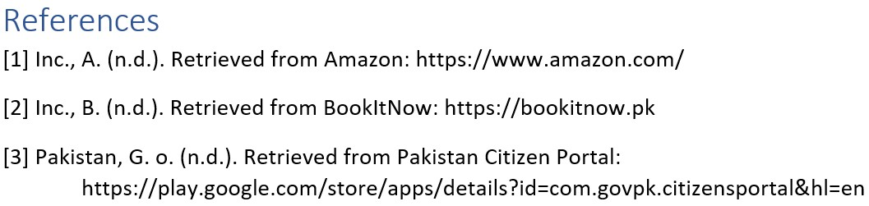
References
_______________________________
_______________________________
11/12/2020
FYP Internal Presentation
44

Slide 45


11/12/2020
FYP Internal Presentation
45
Notes:
45

